Slide 1
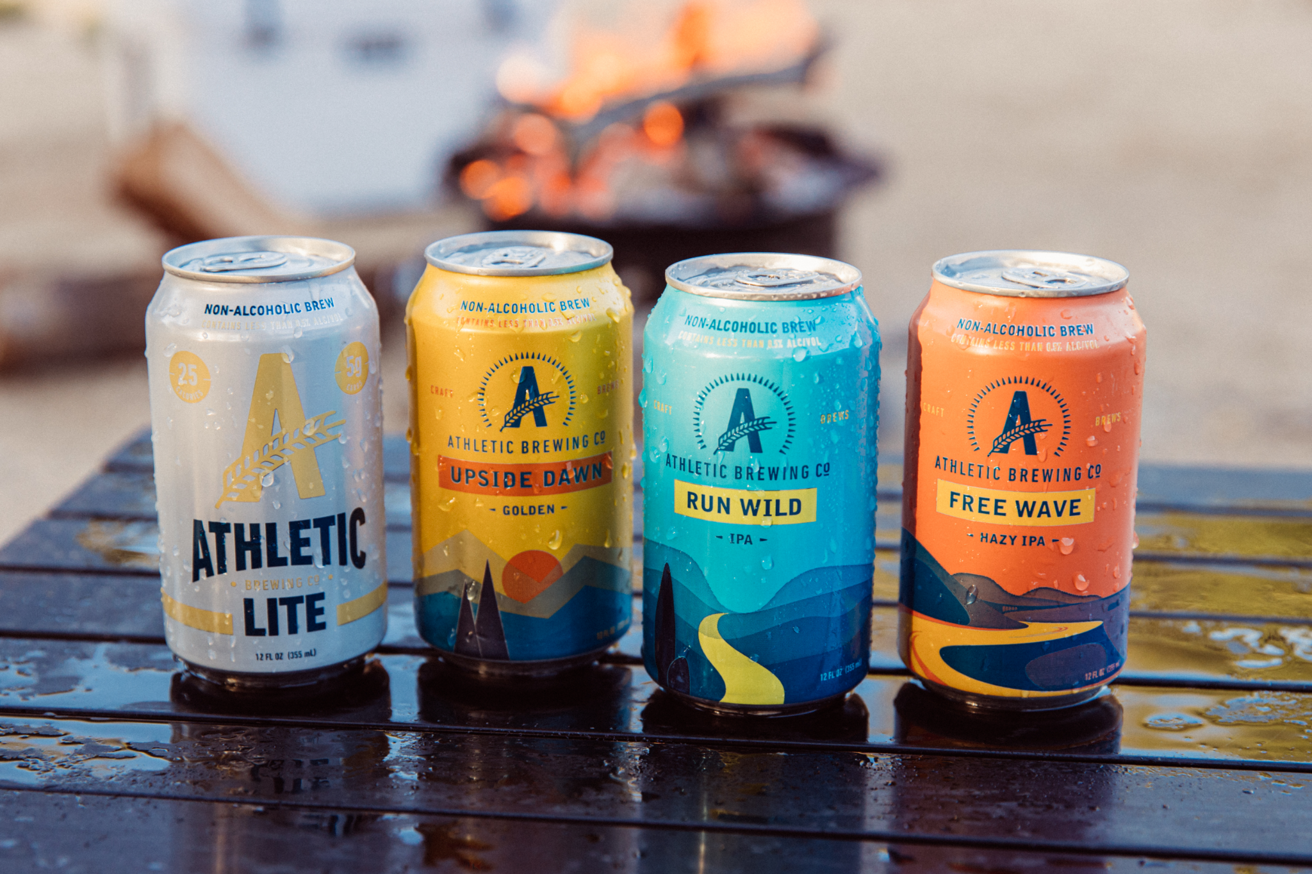
Coca-Cola’s adult NA beverage line
Shruthi Janakiraman, Milouni Sheth, Priyanka Jangid, Jeffrey Gao
April 23, 2025

Slide 2
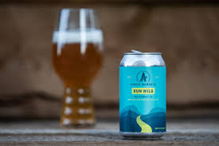
AGENDA
01
Make or buy?
02
Brand alignment, target market and product line
03
Synergy
04
SWOT
05
Positioning Map
06
Differentiation Strategy
07
Marketing Strategy

Slide 3
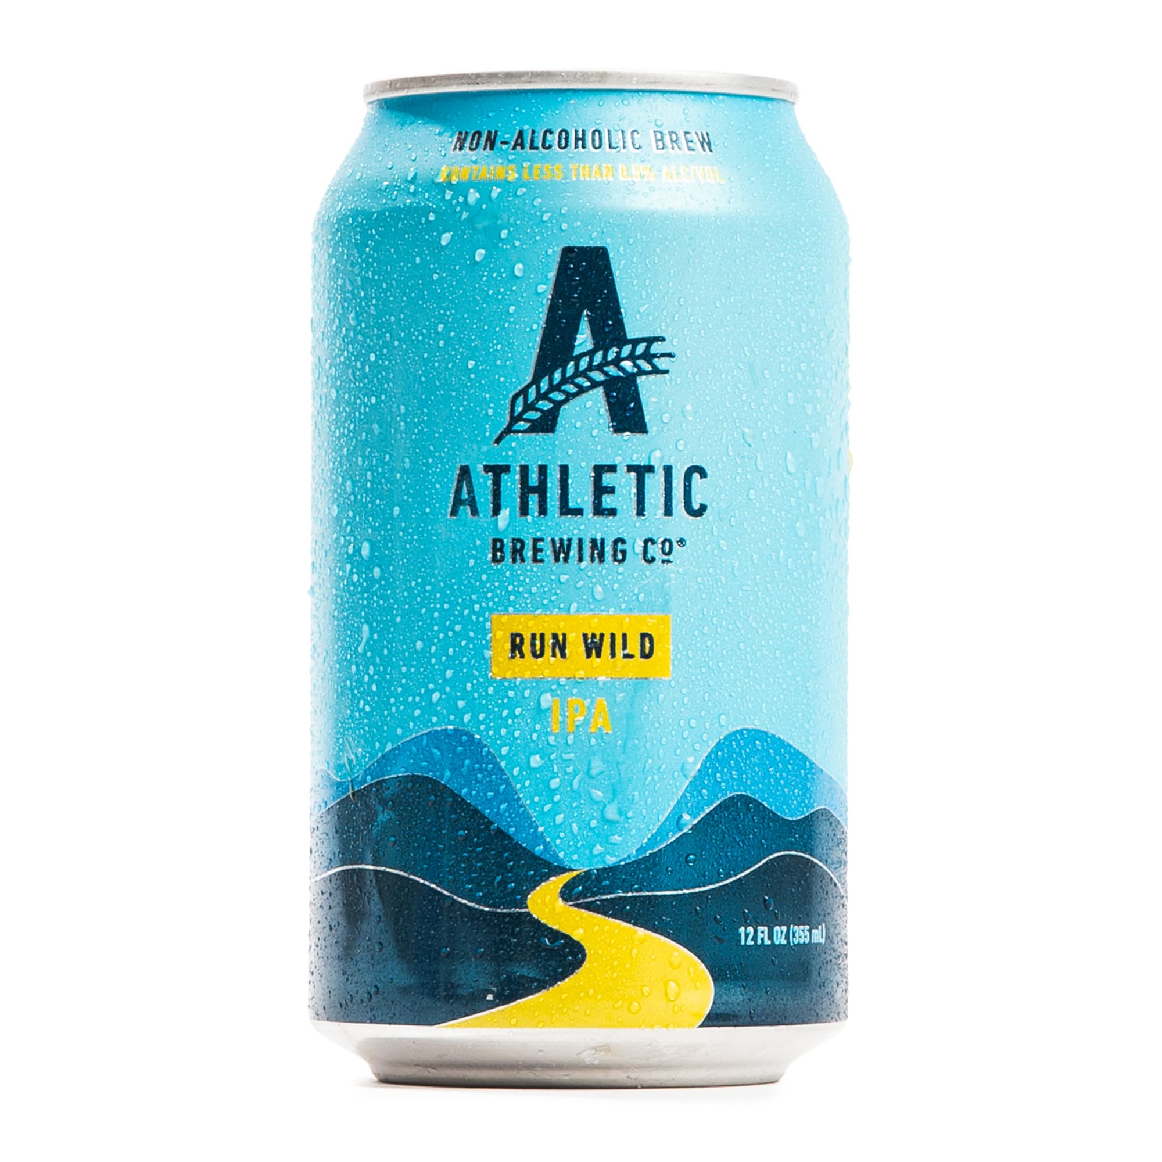
Speed to Market: Developing a new product line from scratch or reviving a pre-existing brand can potentially taking years. An acquisition allows Coca-Cola to immediately gain products, manufacturing capabilities, etc. Non-alcoholic beer alone is a 40B market in US in 2025.
Brand Credibility and Market Position: Athletic Brewing is an established market leader in the non-alcoholic craft beer space, known for quality and innovation. Acquiring them gives Coca-Cola instant credibility in a market it doesn't currently dominate. Founded in 2017, it has a 800 mil valuation in 2024.
Innovation and manufacturing: Athletic Brewing has already invested in brewing technology and flavor innovation as well as manufacturing facility on both coasts. Coca-Cola gains this IP and know-how instantly, and can also excel at scaling production
Make or Buy - Acquiring Athletic brewing company

Slide 4

Brand Alignment
Strategic Portfolio Expansion and Cultural Fit
Sustainability and Purpose
Target Market
Product Line
Coca-Cola has been expanding beyond traditional soda (e.g., through Simply,, Fairlife, and BodyArmor). Athletic fits well in a modern portfolio aimed at health-conscious, lifestyle-oriented adults.
People looking for wellness balance but still enjoy "grown-up" flavors. 25-45, health-conscious, active lifestyle, higher income bracket - fun without the alcohol, socializing without hangovers.
Athletic Brewing Company donates a portion of its sales to trail conservation .The company's commitment has grown over the years, with a donation of $2 million in 2024. Coca-Cola is investing in ESG initiatives and could benefit from Athletic’s positive brand equity in the space of sustainability and social impact.
Athletic isn’t just about beer — it represents an adult-focused non-alcoholic lifestyle brand. On top of the existing product lineup, Coca-Cola could use Athletic’s brewing expertise to develop NA beer-based mocktails or functional beverages to further diversify the product line appeal.

Slide 5
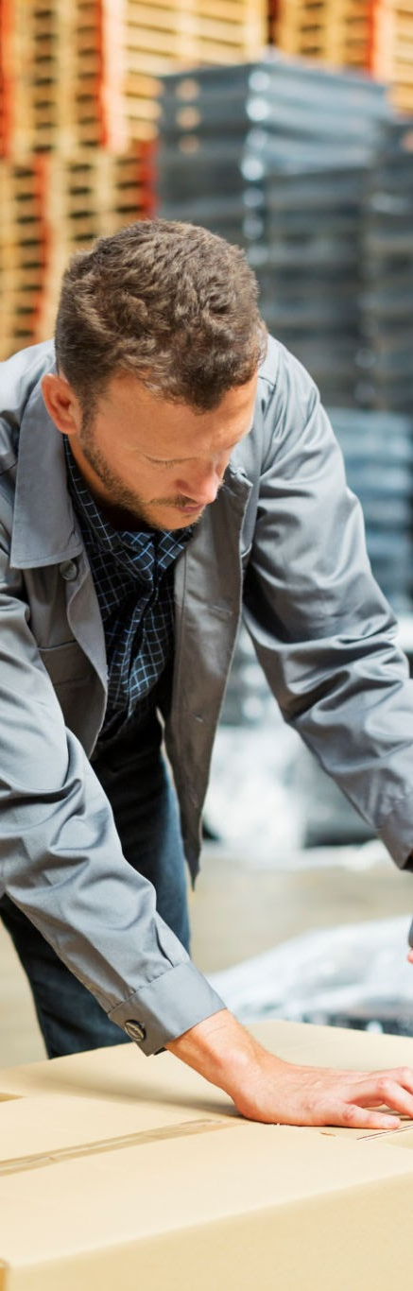
Synergy
Partnership with Coke will allow Athletic Brewing to gain their global distribution methods
Coke can finally step into a new market with Athletic Brewing and appeal to their more health conscious consumers
They both can benefit from each others loyal consumer market
Athletic Brewing can gain more marketing help and put their product out in more locations with cokes help.
Notes:
- Established relationships with regulators and supply chain players. Loyal niche market and credibility in wellness space. Together, the partnership is a win-win: it brings health-forward innovation to Coca-Cola’s lineup and supercharges Athletic Brewing’s growth. This partnership is a win-win.”
“Athletic Brewing gains access to Coca-Cola’s global distribution and marketing power, helping them scale fast.”
“Meanwhile, Coke gets to enter the non-alcoholic craft beer space and connect with health-conscious consumers.”
“Together, they can reach new audiences and strengthen their brands by tapping into each other’s loyal customer bases.”

Slide 6
SWOT Coke
Strengths Strong Brand recognition Massive distribution network Strong partnerships Diversified Products | Weakness Reliance on their soft drinks Environmental concerns
Opportunities Launching more health conscious drink Expansion into emerging markets Strategic Alliances | Threats Increase in Health conscious consumer Water Usage Controversy Pollution Lawsuits
Notes:
- Established relationships with regulators and supply chain players. Loyal niche market and credibility in wellness space. Together, the partnership is a win-win: it brings health-forward innovation to Coca-Cola’s lineup and supercharges Athletic Brewing’s growth. This partnership is a win-win.”
“Athletic Brewing gains access to Coca-Cola’s global distribution and marketing power, helping them scale fast.”
“Meanwhile, Coke gets to enter the non-alcoholic craft beer space and connect with health-conscious consumers.”
“Together, they can reach new audiences and strengthen their brands by tapping into each other’s loyal customer bases.”

Slide 7
SWOT Athletic
Strengths Appeals to the Health conscious demographic Leader in the non alcoholic craft beer market Innovative Process Value Sustainability | Weakness Niche market Pricing Not as known compared to regular beers
Opportunities Take advantage of incorporating more flavours Demand for non alcoholic beers | Threats Competition within the non alcoholic beer space Competition with other healthy drinks Rising Operational Costs
Notes:
- Established relationships with regulators and supply chain players. Loyal niche market and credibility in wellness space. Together, the partnership is a win-win: it brings health-forward innovation to Coca-Cola’s lineup and supercharges Athletic Brewing’s growth. This partnership is a win-win.”
“Athletic Brewing gains access to Coca-Cola’s global distribution and marketing power, helping them scale fast.”
“Meanwhile, Coke gets to enter the non-alcoholic craft beer space and connect with health-conscious consumers.”
“Together, they can reach new audiences and strengthen their brands by tapping into each other’s loyal customer bases.”

Slide 8
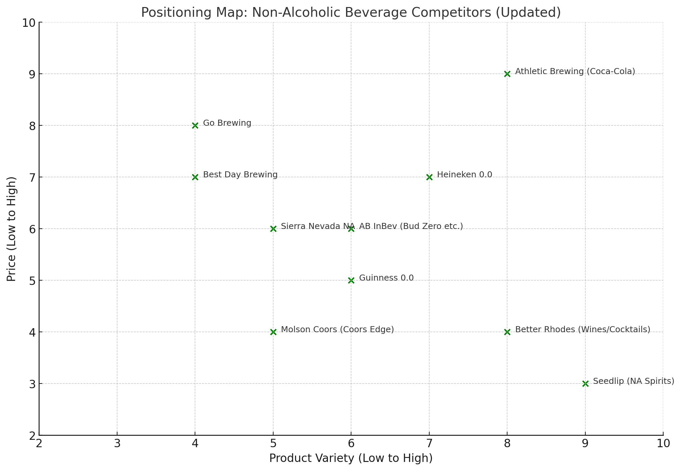
Competitive Analysis - Positioning Map
Done with AI aid

Slide 9
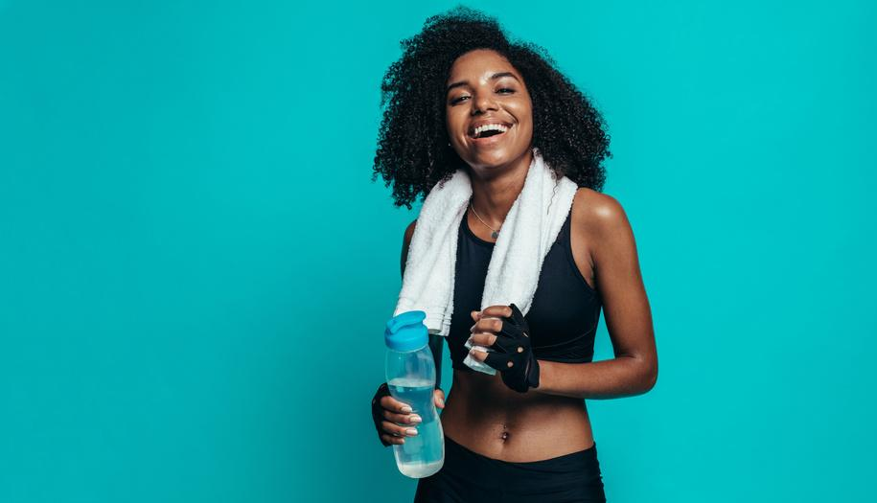
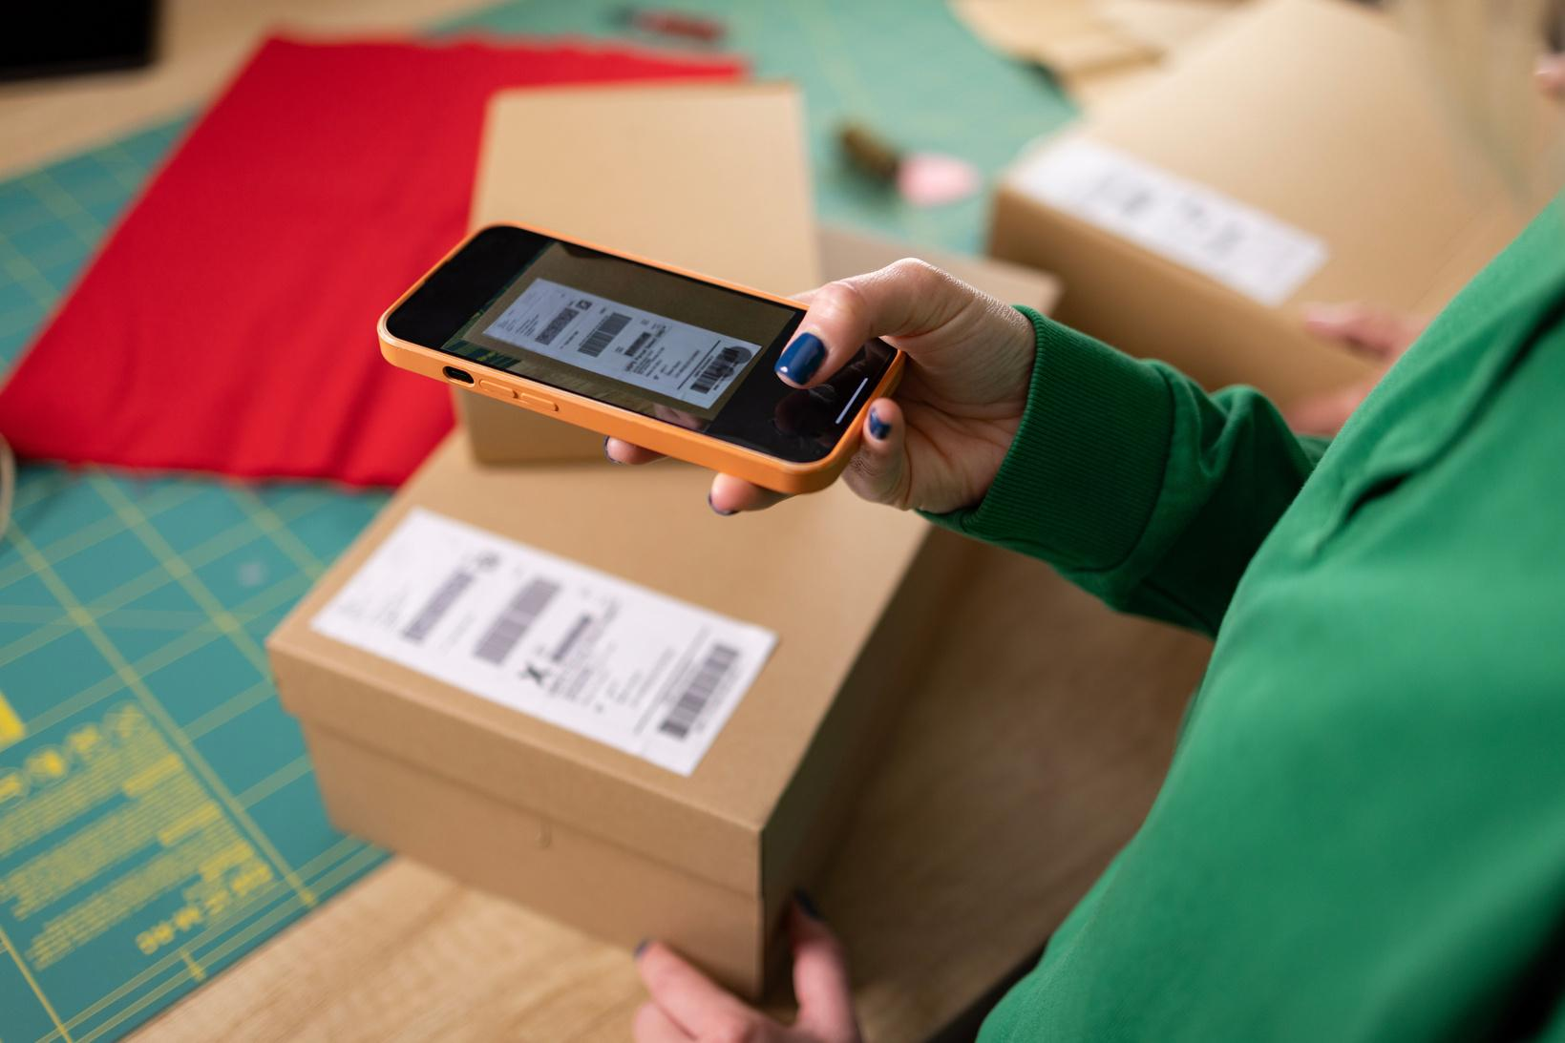


Differentiation strategy - Brand positioning and identity
“Brewed for performance, crafted for life”
Performance - driven, wellness centered, cleaner lifestyle
Social Media
Visual Identity Refresh
Mental Wellness
Social media campaigns with wellness and lifestyle influencers - recipes, fitness challenges
This includes telling the story of NA beer by and for athletes via the packaging. AR labels that tie into community building as well.
This is a Blue Ocean area that will be explored by promoting a mental wellness line (brewed with calming herbs) and promoted in spas and meditation centers

Slide 10
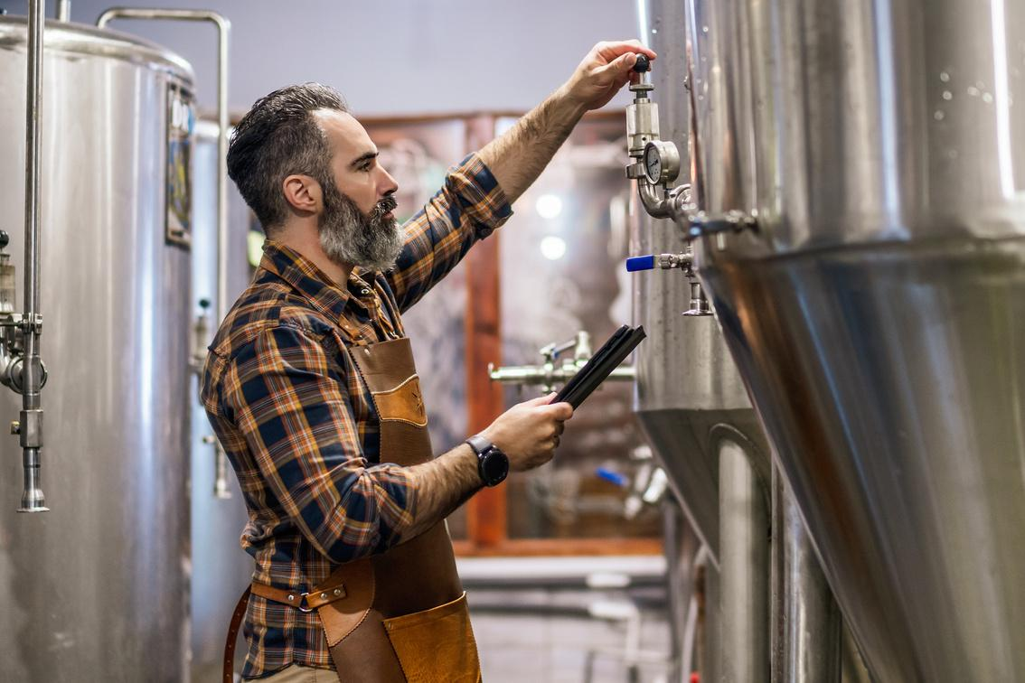
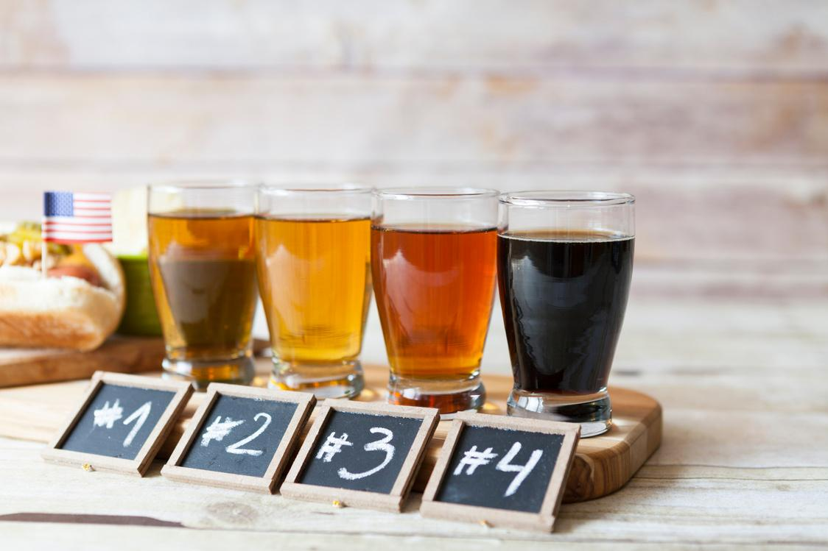
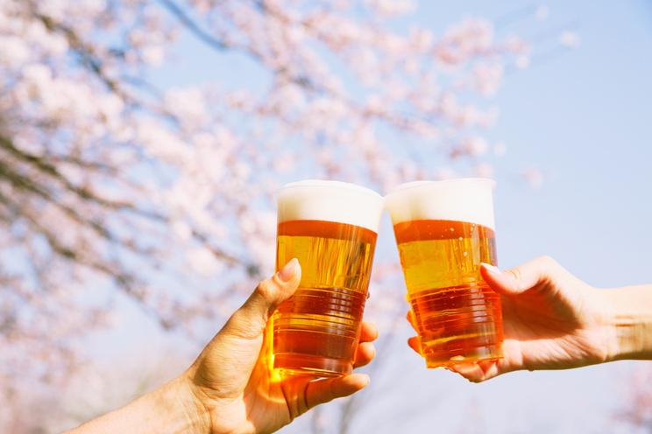
Differentiation strategy - Product Quality and Diversity
Product lines include all beer types (light, dark, sour) as well as 2 sizes across 10 flavors
Product Quality
Seasonal Brews + Mix Packs
Fitness Brews
The products to be positioned as not just great non alcoholic beer but great beer. Actions - Small pilot batches and an R&D lab, quality controls and consumer feedback integration
Product lines that are limited editions, seasonal, and region specific to appeal to all preferences. Mix packs would enable flavor exploration while merch would help build community
Further exploring the Blue Ocean space are product lines crafted specifically for mental wellness, athletic recovery (post-recovery workouts, brews with BCAAs, electrolytes)

Slide 11
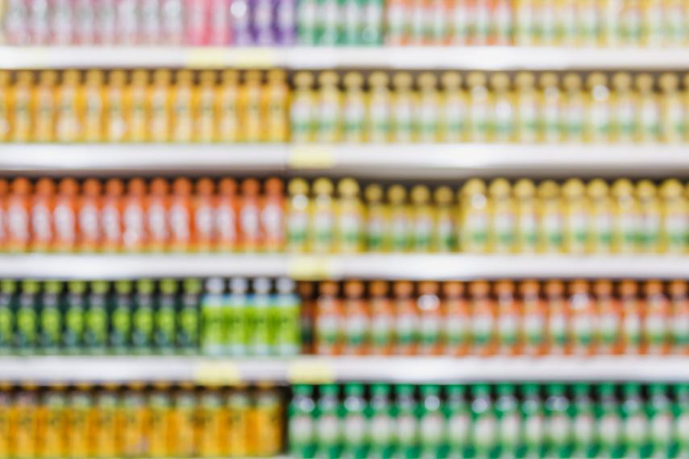
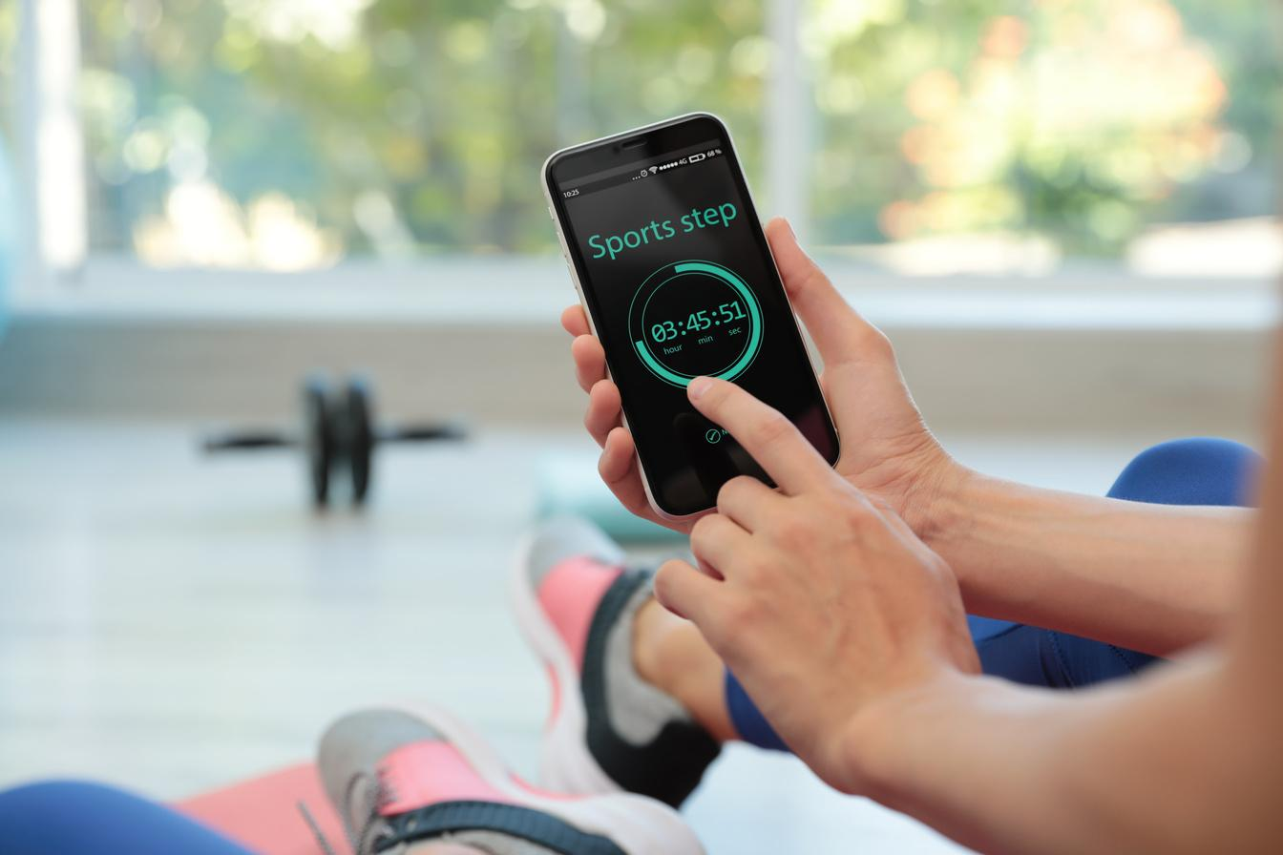
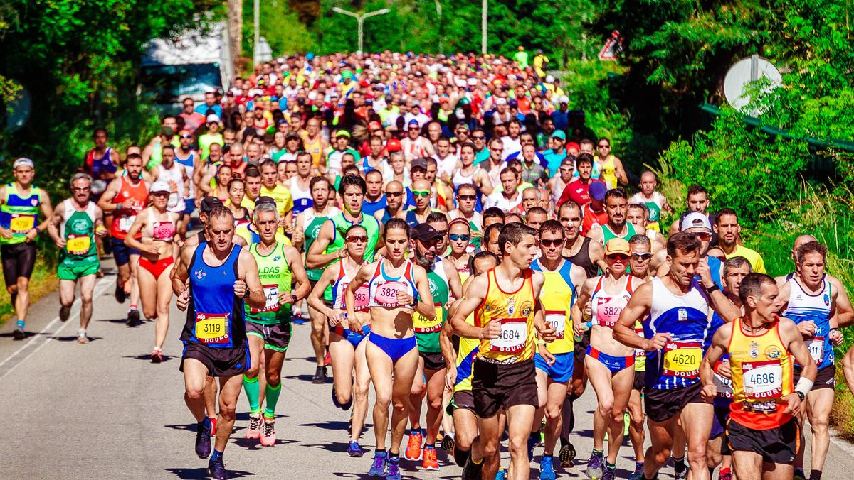
Differentiation strategy - Consumer Experience
Product lines available via direct and indirect B2C channels (retail stores, gyms, wellness centers) leveraging Coca Cola’s massive distribution scale and capacity. Also, available D2C via websites.
In-store experiences
Digital Experiences
Pop-Up Events
The products to be given premium shelf space via Coca Cola’s network, availability of mini travel cans and taste flight packs. Taps to be installed in indirect B2C channels
Pop-up events for sober curious individuals in bars and restaurants, stalls in sports and wellness related events such as marathons, Athletic Co inspired yoga sessions or cold plunges
Integration of fitness tracking and challenges in Athletic Co’s app. Gamified reward systems for regular app users.

Slide 12









Marketing Strategy
Q2: Wellness and Balance
Q4: Celebration and Reflection
Drop campaign for mental wellness product line, wellness pop-up events and influencer partnerships
Campaign and pop up events for limited edition and seasonal brew drops, promoted by athletes and recipe creators
Q1: Performance and Purpose
Q3: Community and Discovery
Push for user generated content, fitness challenges on app tied with rewards, social media fitness campaign, Sober Stars vlogs
Announce acquisition and brand refresh, roll out new packaging, presence in podcasts, magazines, blogs

Slide 13
THANK YOU

Slide 14
References
https://athleticbrewing.com/
https://sinuatemedia.com/non-alcoholic-beer-soaring-40-billion-dollars/#:~:text=Non%2DAlcoholic%20Beer%20Soberly%20Soaring,of%20the%20craft%20beer%20market.
https://www.thedailyupside.com/industries/consumer/americas-biggest-non-alcoholic-beer-company-valued-at-800-million/
https://www.prnewswire.com/news-releases/athletic-brewing-company-announces-2-million-two-for-the-trails-donation-to-protect-and-restore-outdoor-spaces-302330751.html
https://bstrategyhub.com/swot-analysis-of-coca-cola-2019-coca-cola-swot-analysis
https://www.marketing91.com/swot-coca-cola/

Slide 15
Appendix

Slide 16
PESTEL for Coke & Athletic Brewing
Political:
Coca-Cola: Subject to global regulations (health, taxation, packaging).
Athletic Brewing: Regulations on non-alcoholic beverages and alcohol laws.
Economic:
Coca-Cola: Impact of currency fluctuations, health-conscious shift affecting soda sales.
Athletic Brewing: Growing demand for non-alcoholic beer, pricing pressures.
Social:
Coca-Cola: Shift towards healthier options, increasing concern for sustainability.
Athletic Brewing: Targets health-conscious consumers, eco-friendly and sustainable practices.
Done with AI aid

Slide 17
PESTEL for Coke & Athletic Brewing
Technological:
Coca-Cola: Advanced manufacturing, e-commerce, and digital marketing.
Athletic Brewing: Uses innovation in brewing technology and direct-to-consumer strategies.
Environmental:
Coca-Cola: Pressure on reducing plastic, water conservation, and carbon emissions.
Athletic Brewing: Eco-friendly packaging, sustainable brewing processes.
Legal:
Coca-Cola: Adherence to labeling, health, environmental regulations, and lawsuits.
Athletic Brewing: Compliance with health and safety standards for non-alcoholic drinks.
Done with AI aid

Slide 18
Porter’s 5 Forces for Coke & Athletic Brewing
1. Threat of New Entrants
Coca-Cola: Low threat due to strong brand, distribution, and economies of scale.
Athletic Brewing: High threat due to market growth in non-alcoholic beverages and new competitors.
2. Bargaining Power of Suppliers
Coca-Cola: Low power due to large-scale purchasing but relies on raw materials.
Athletic Brewing: High power due to reliance on specific ingredients (e.g., hops, barley).
3. Bargaining Power of Buyers
Coca-Cola: Low power; shift to health-conscious and alternative drinks.
Athletic Brewing: High power; consumers can easily switch to other non-alcoholic options.
4. Threat of Substitutes
Coca-Cola: High threat from water, energy drinks, juices, and health drinks.
Athletic Brewing: High threat from non-alcoholic beverages, kombucha, and other health-focused drinks.
5. Industry Rivalry
Coca-Cola: High rivalry with competitors like PepsiCo, Nestlé, and emerging health brands.
Athletic Brewing: High rivalry with large non-alcoholic beer companies and craft beer brands.
Done with AI aid

